Slide 1
Introduction to WASP7 Eutrophication Module
Overview of Variables and Processes Implemented in WASP7 Eutrophication Module

Slide 2
Good Reference Materials
Rates, Constants, and Kinetics
  http://www.epa.gov/ORD/WebPubs/surfaceH2O/surface.html
Steve Chapra
  Surface Water Quality Modeling
James Martin
  Hydrodynamics and Transport for Water Quality Modeling
Thomann and Mueller
  Principles of Surface Water: Quality Modeling and Control

Slide 3
WASP7 State Variables
Ammonia
Nitrate
Orthophosphate
Dissolved Oxygen
Salinity
Phytoplankton
Periphyton
Particulate Detritus
  Carbon
  Nitrogen
  Phosphorus
Dissolved Organic Matter
  CBOD (1)
  CBOD (2)
  CBOD (3)
  DON
  DOP

Slide 4
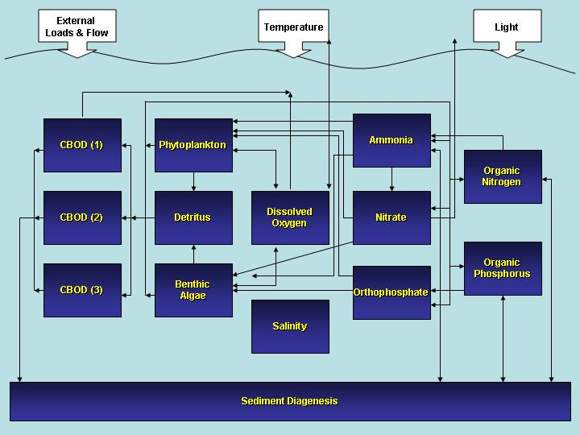
Eutrophication Diagram

Slide 5
Processes Considered
Phytoplankton Kinetics
Periphyton Kinetics
Phosphorus Cycling
Nitrogen Cycling
Dissolved Oxygen Balance
Sediment Diagenesis

Slide 6
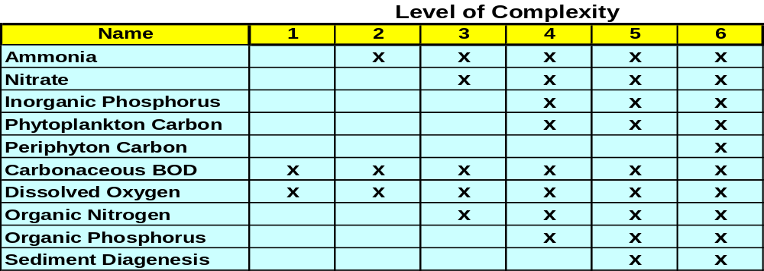
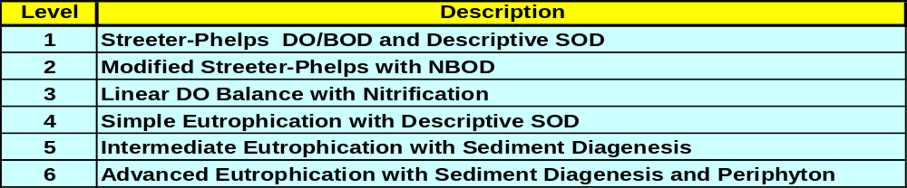
Levels of Complexity in Implementing WASP7 Eutrophication Model

